Slide 1


STARBUCKS
Beverages Nutrition
BY Vipul Arora

Slide 2
CONTENTS
1. Introduction
2. Beverage Categories
3. Nutrients Information
4. Average Nutrients Vs Daily Threshold Limit
5. Distribution of Drinks in Different Cup Sizes
6. Distribution of Drinks in Different Beverage Categories
7. Top 3 Healthy Beverage categories
8. Top 5 Healthy Drinks
9. Can you consume Starbucks drink twice ?
10. Conclusion
Notes:
Changes kare hai content section mein

Slide 3



It’s not just coffee
It’s Starbucks

Slide 4
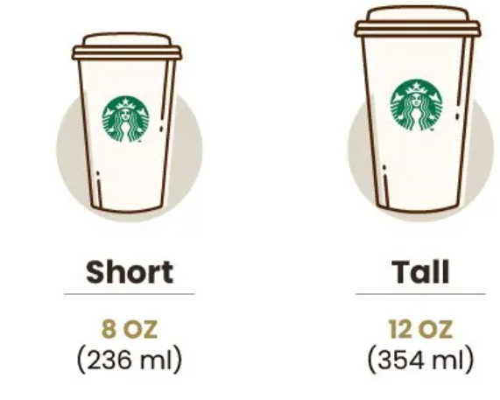
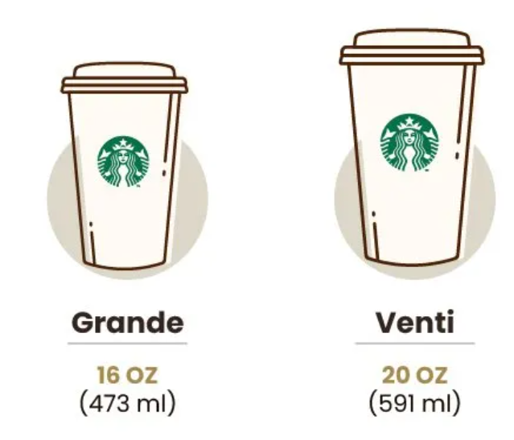
Different Beverages Categories
Customizations
Classic Espresso Drinks | Coffee | Frappuccin Blended Coffee | Frappuccino Blended Creme | Frappuccino Light Blended Coffee | Shaken Iced Beverages | Signature Espresso Drinks | Smoothies | Tazo Tea Drinks
Caffe Americano | Brewed Coffee | Caramel (Without Whipped Cream) | Strawberries & Creme (Without Whipped Cream) | Caramel | Iced Brewed Coffee (With Classic Syrup) | Caramel Apple Spice (Without Whipped Cream) | Banana Chocolate Smoothie | Tazo Chai Tea Latte
Caffe Latte |  | Coffee | Vanilla Bean (Without Whipped Cream) | Coffee | Iced Brewed Coffee (With Milk & Classic Syrup) | Caramel Macchiato | Orange Mango Banana Smoothie | Tazo Full-Leaf Red Tea Latte (Vanilla Rooibos)
Caffe Mocha (Without Whipped Cream) |  | Java Chip (Without Whipped Cream) |  | Java Chip | Shaken Iced Tazo Tea (With Classic Syrup) | Hot Chocolate (Without Whipped Cream) | Strawberry Banana Smoothie | Tazo Full-Leaf Tea Latte
Cappuccino |  | Mocha (Without Whipped Cream) |  | Mocha | Shaken Iced Tazo Tea Lemonade (With Classic Syrup) | White Chocolate Mocha (Without Whipped Cream) |  | Tazo Green Tea Latte
Espresso |  |  |  |  |  |  |  | Tazo Tea
Skinny Latte (Any Flavour)
Vanilla Latte (Or Other Flavoured Latte)
Nonfat Milk
2% Milk
Soymilk
Whole Milk
Cup Sizes

Slide 5

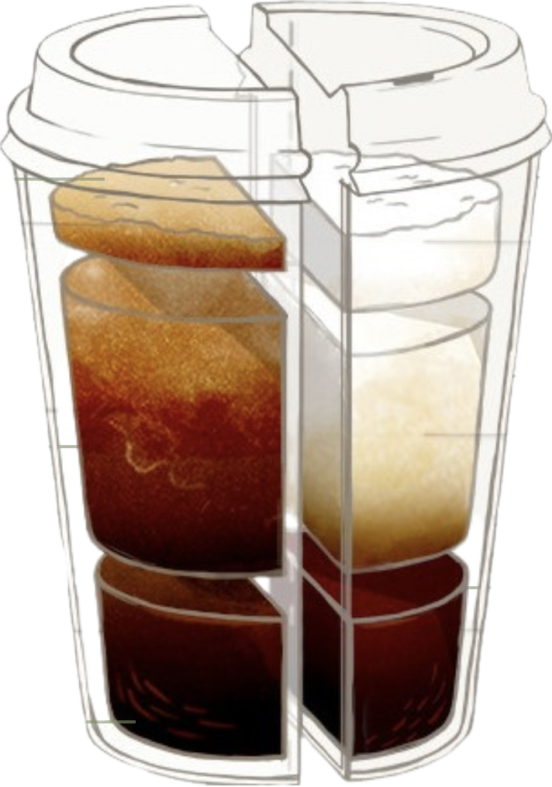
Energy
Calories
Caffeine
Carbohydrates
Total Carbohydrates
Dietary Fiber
Sugars
Fats
Total Fat
Trans Fat
Saturated Fat
Nutrients
Protein
Cholesterol
Minerals
Sodium
Calcium, Iron
Vitamins:
Vitamin A
Vitamin C

Slide 6
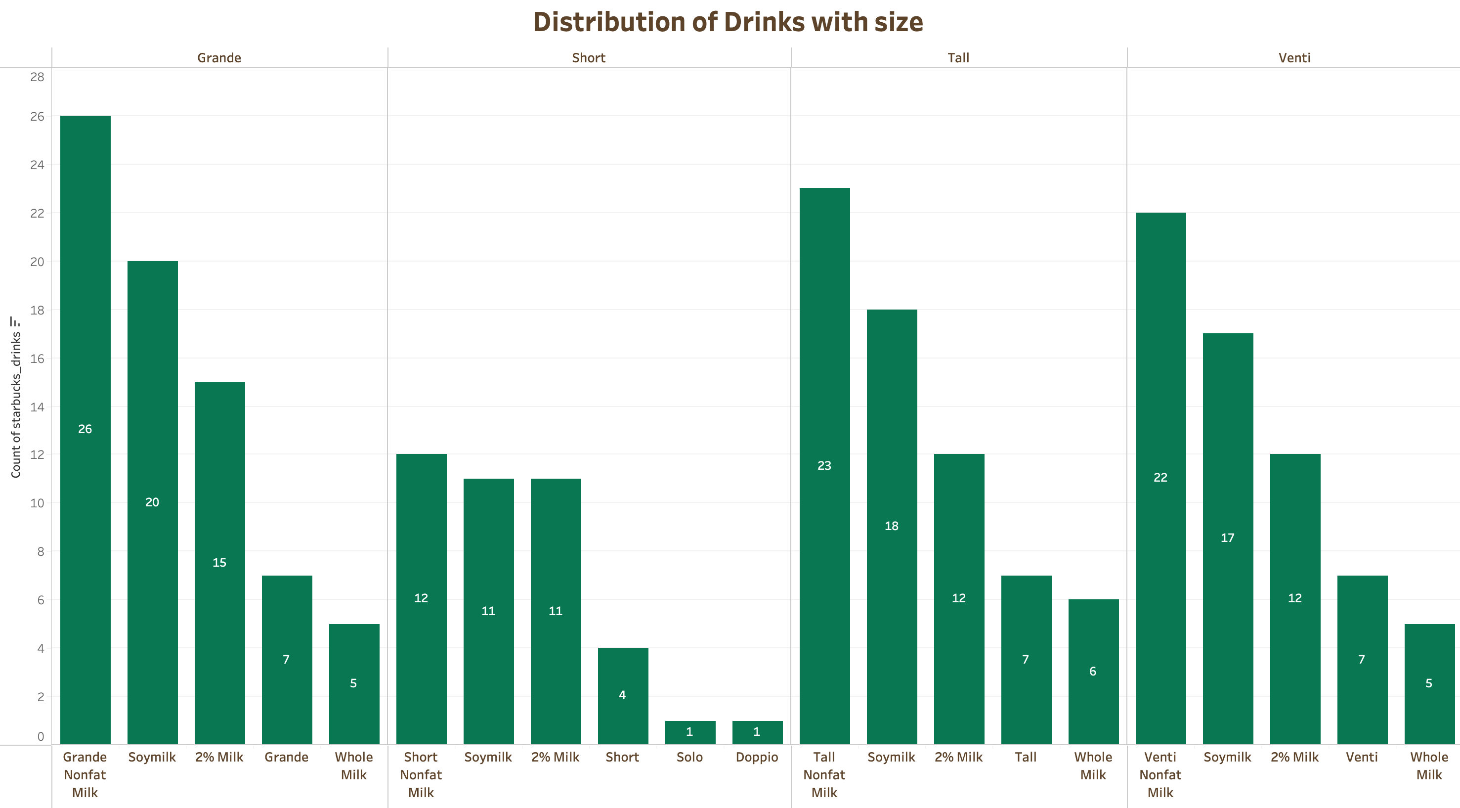
30%
17%
26%
30%
27%
Notes:
Refer to Watsapp Msg, heading mein size ke badle cup size aaega

Slide 7
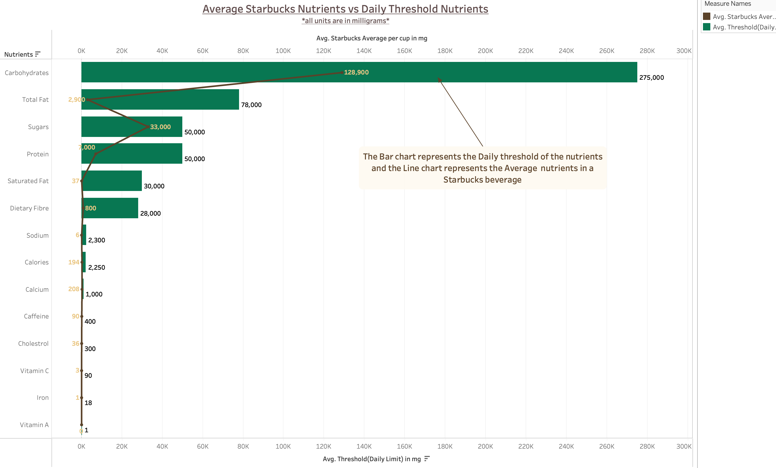
Nutrients | Threshold(Daily Limit) in mg | Starbucks Average Nutrients in mg
Caffeine | 400 | 89.5
Calories | 2250 | 193.9
Protein | 50000 | 7000
Carbohydrates | 275000 | 128900
Total Fat | 78000 | 2900
Saturated Fat | 30000 | 37
Trans Fat | 200 | 1.3
Vitamin A | 0.9 | 0.0882
Vitamin C | 90 | 3.24
Cholestrol | 300 | 36
Dietary Fibre | 28000 | 800
Sodium | 2300 | 6.4
Sugars | 50000 | 33000
Calcium | 1000 | 208
Iron | 18 | 1.332

Slide 8
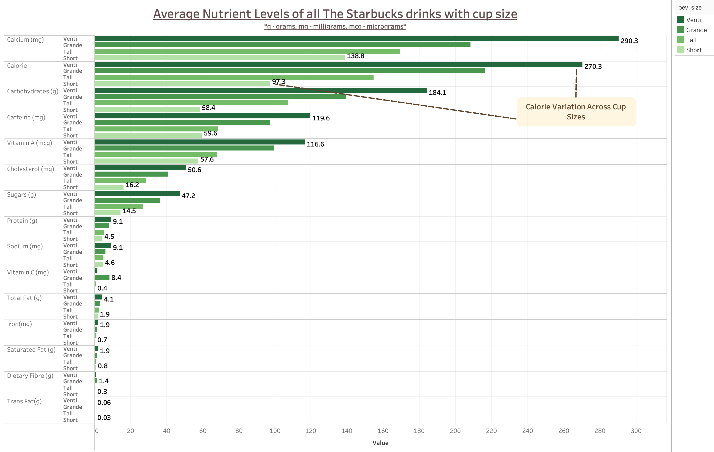

Slide 9
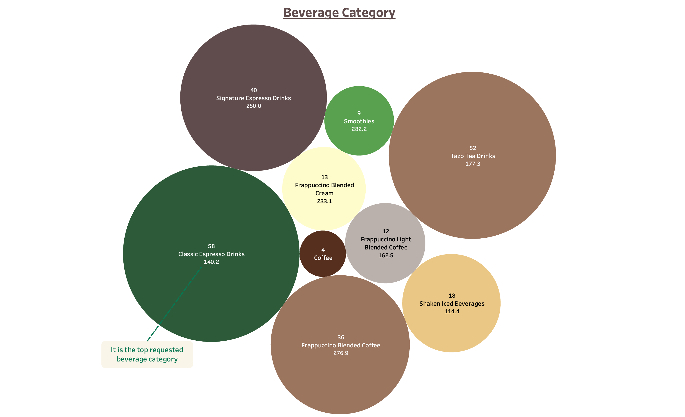
17%
21%
24%
15%
Notes:
Refer Watsapp Msg

Slide 10
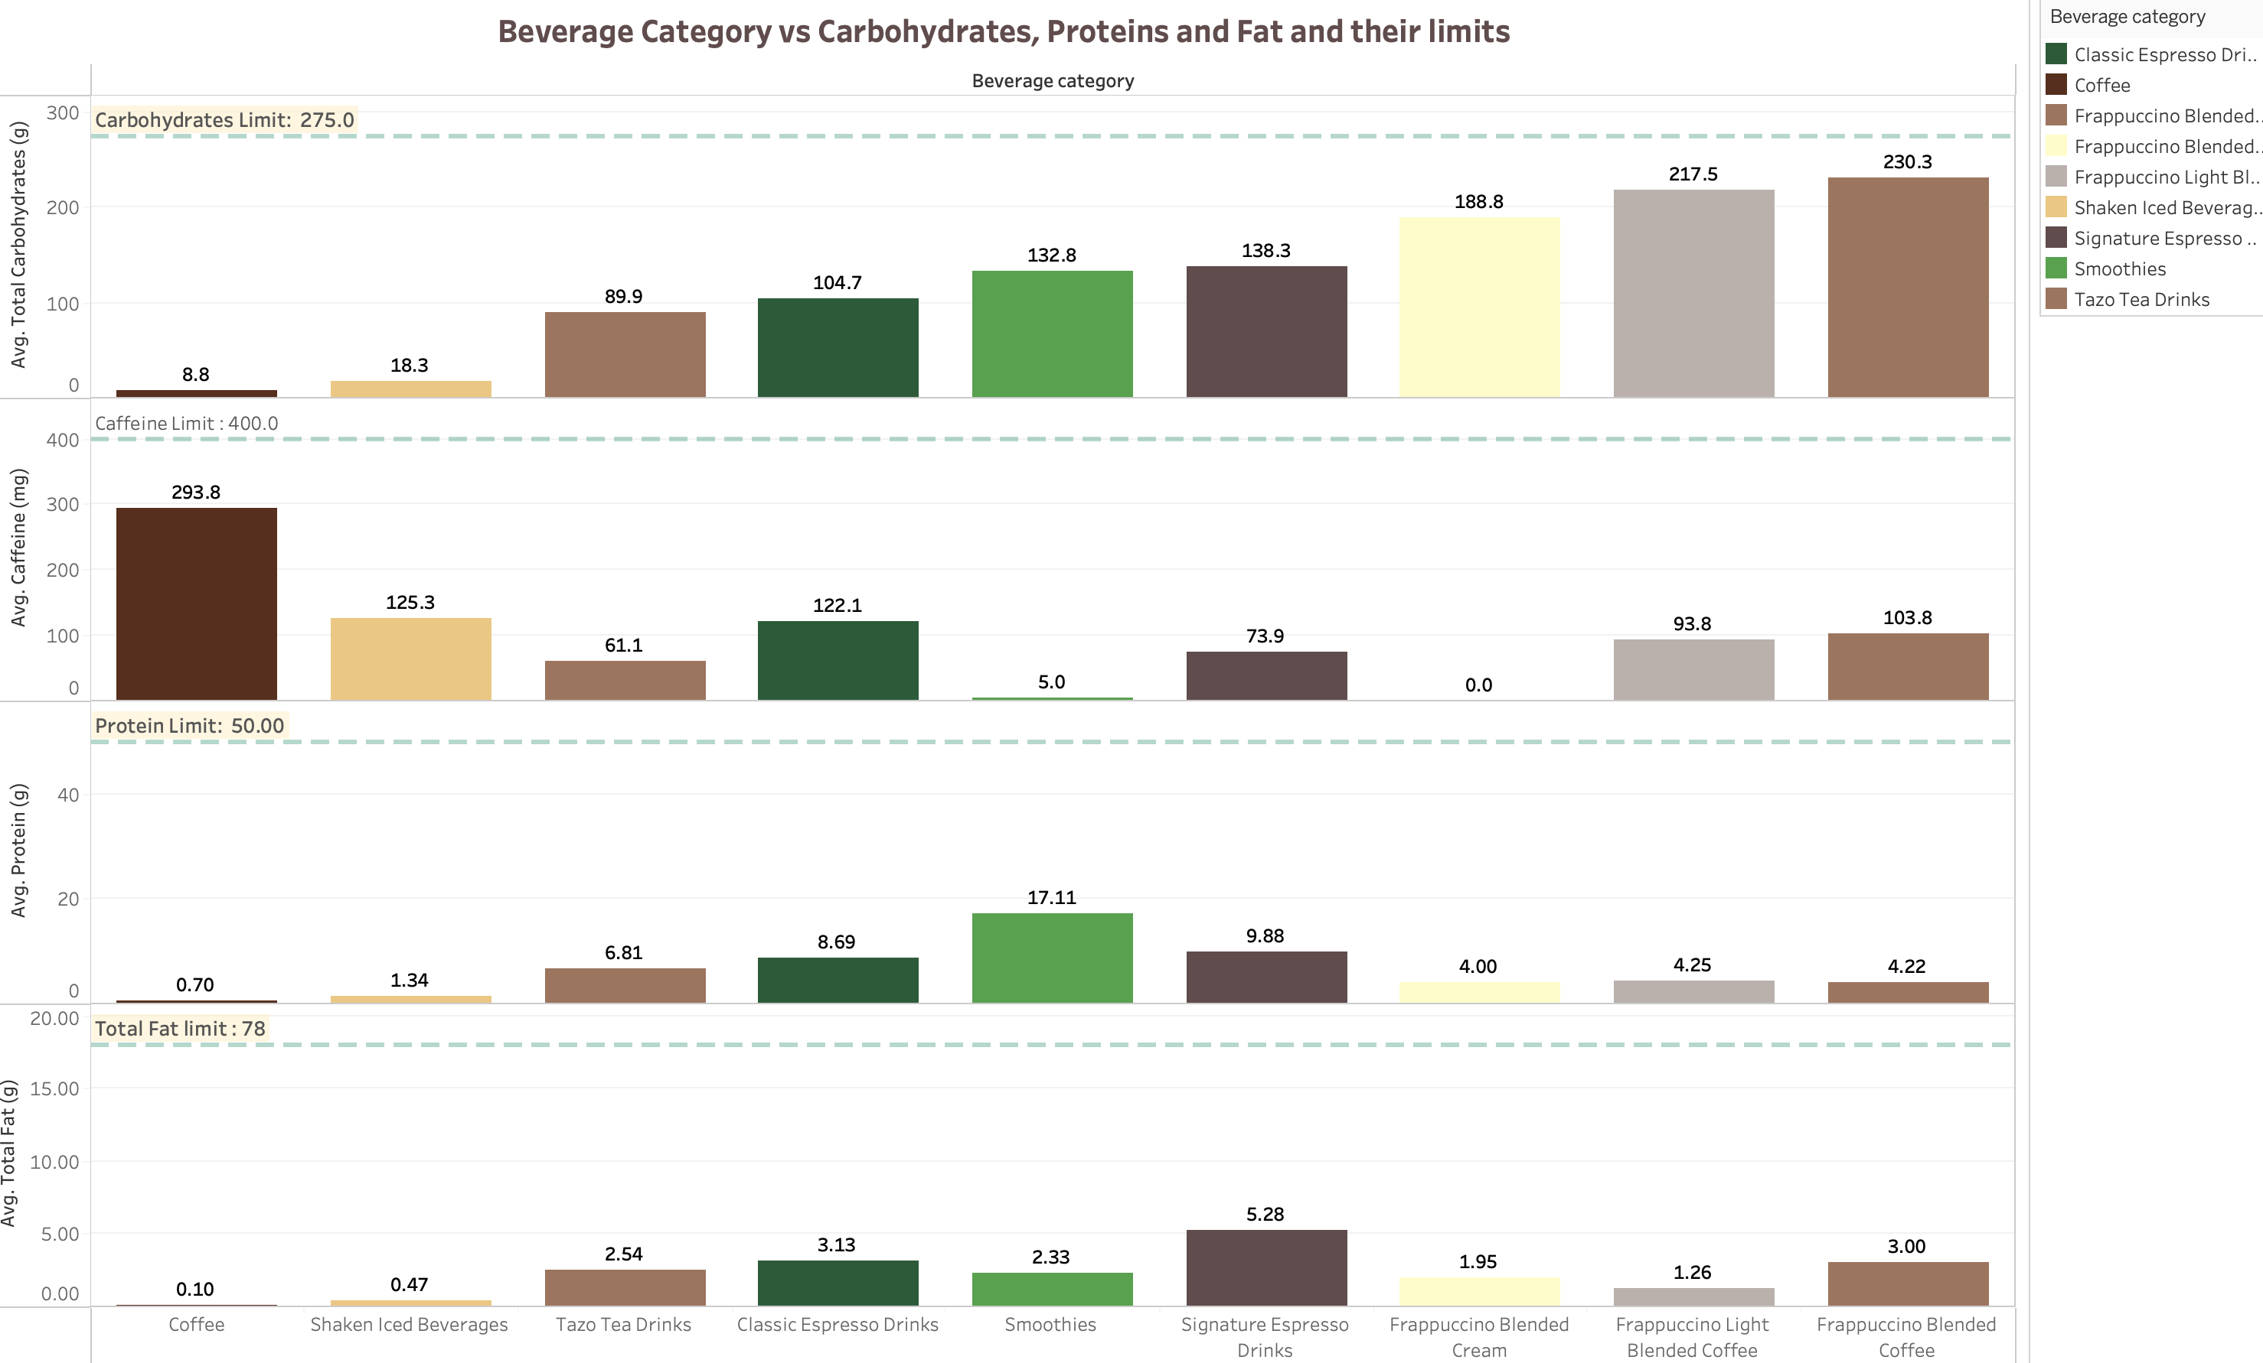

Slide 11
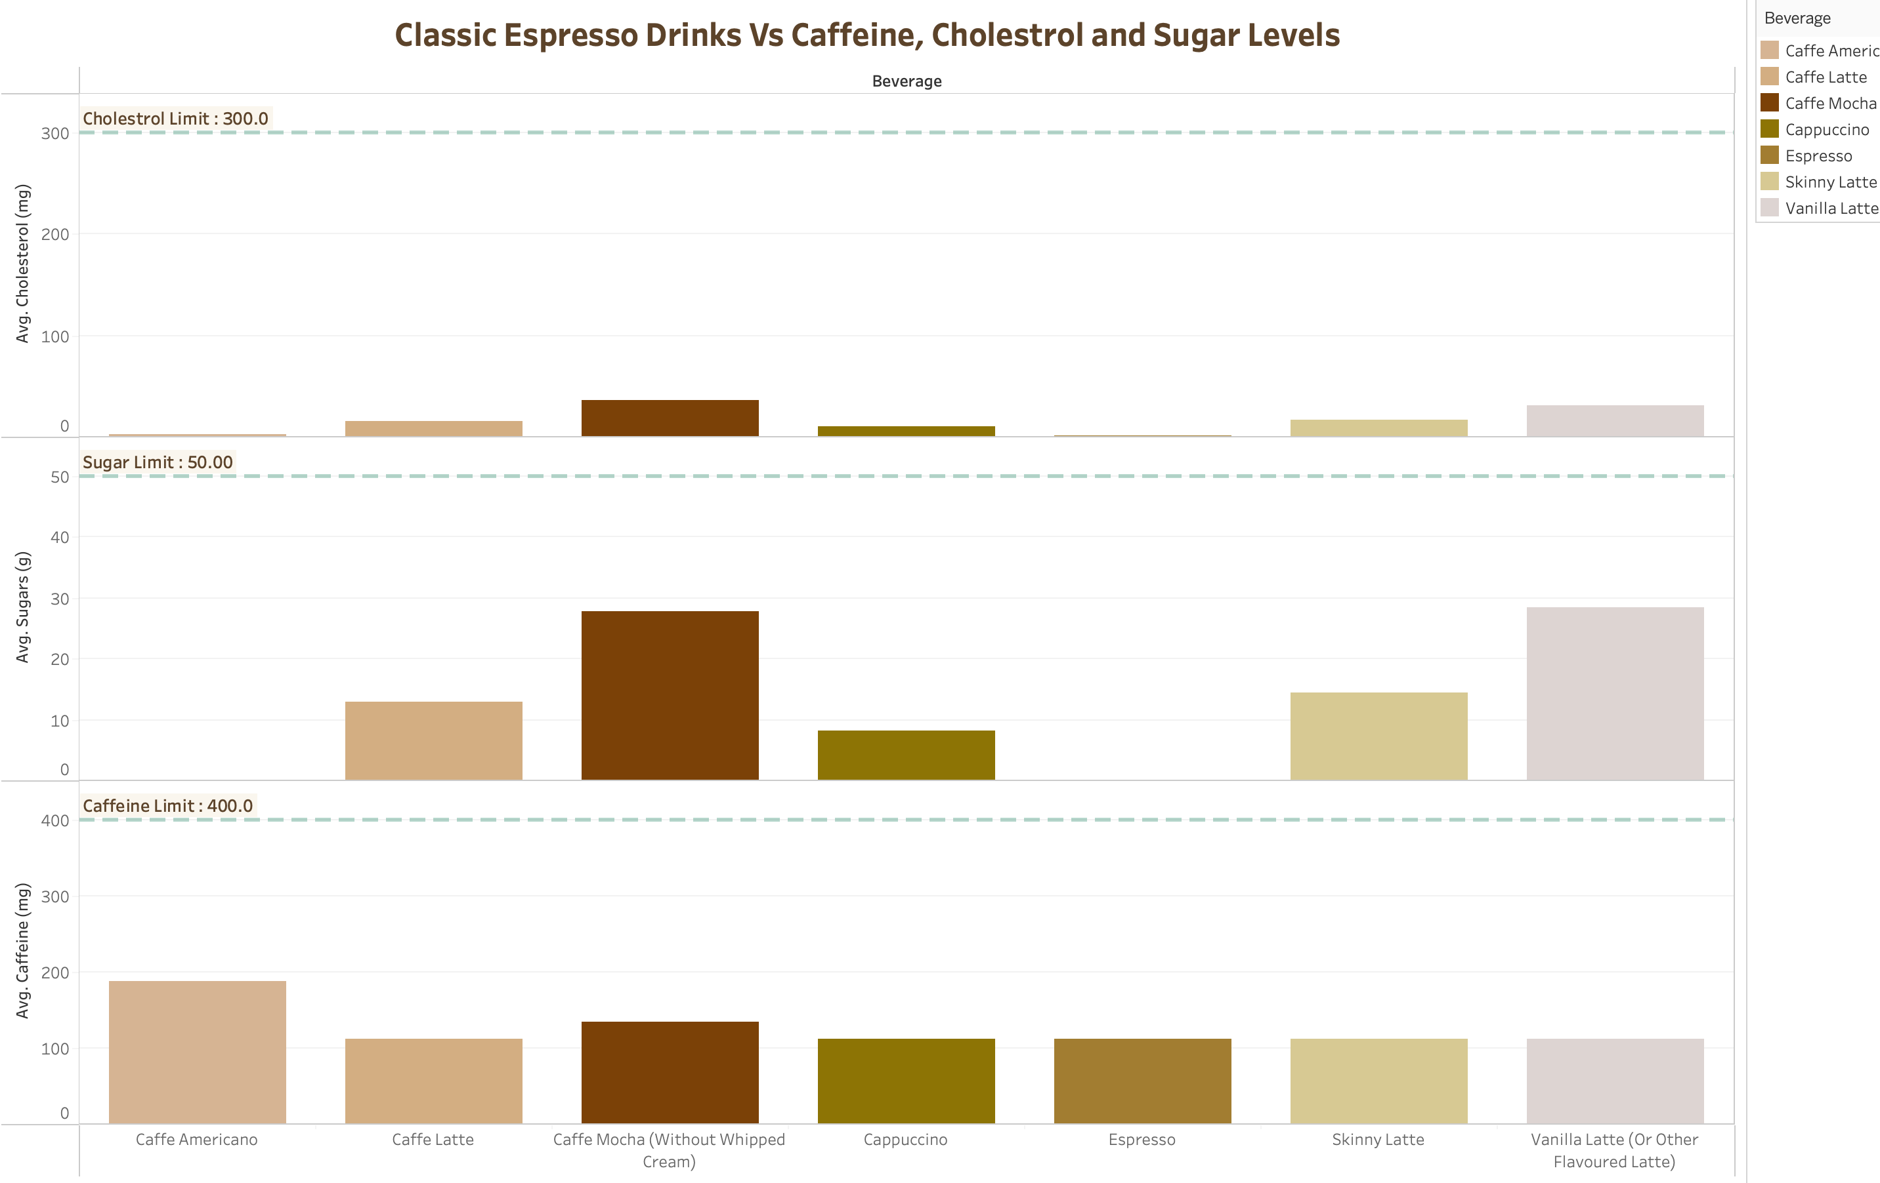
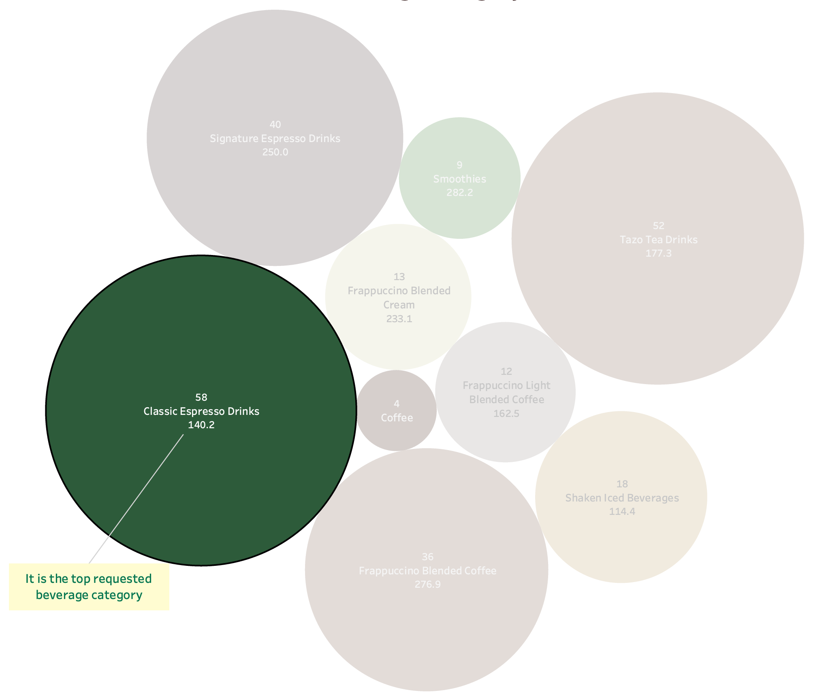

Slide 12
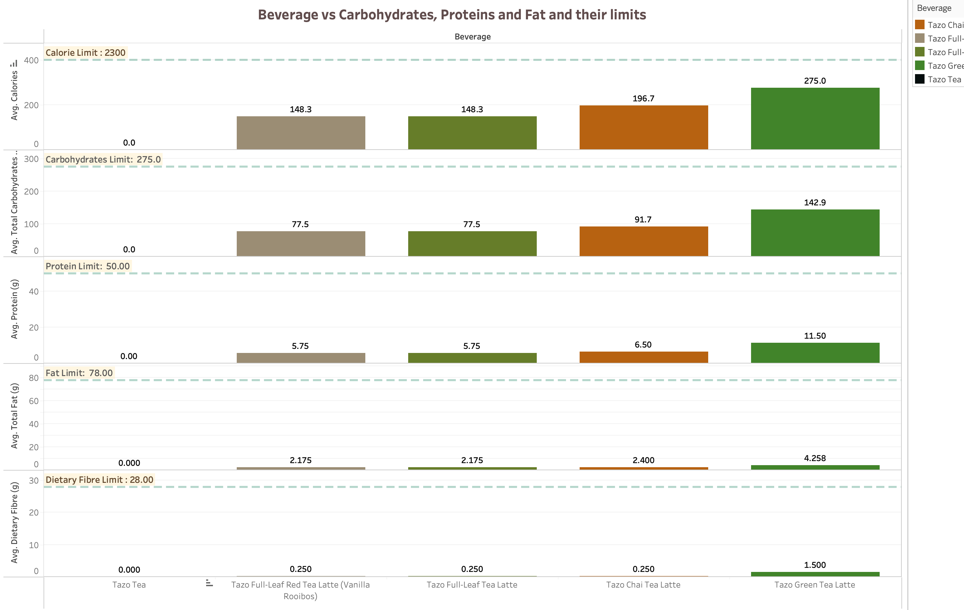
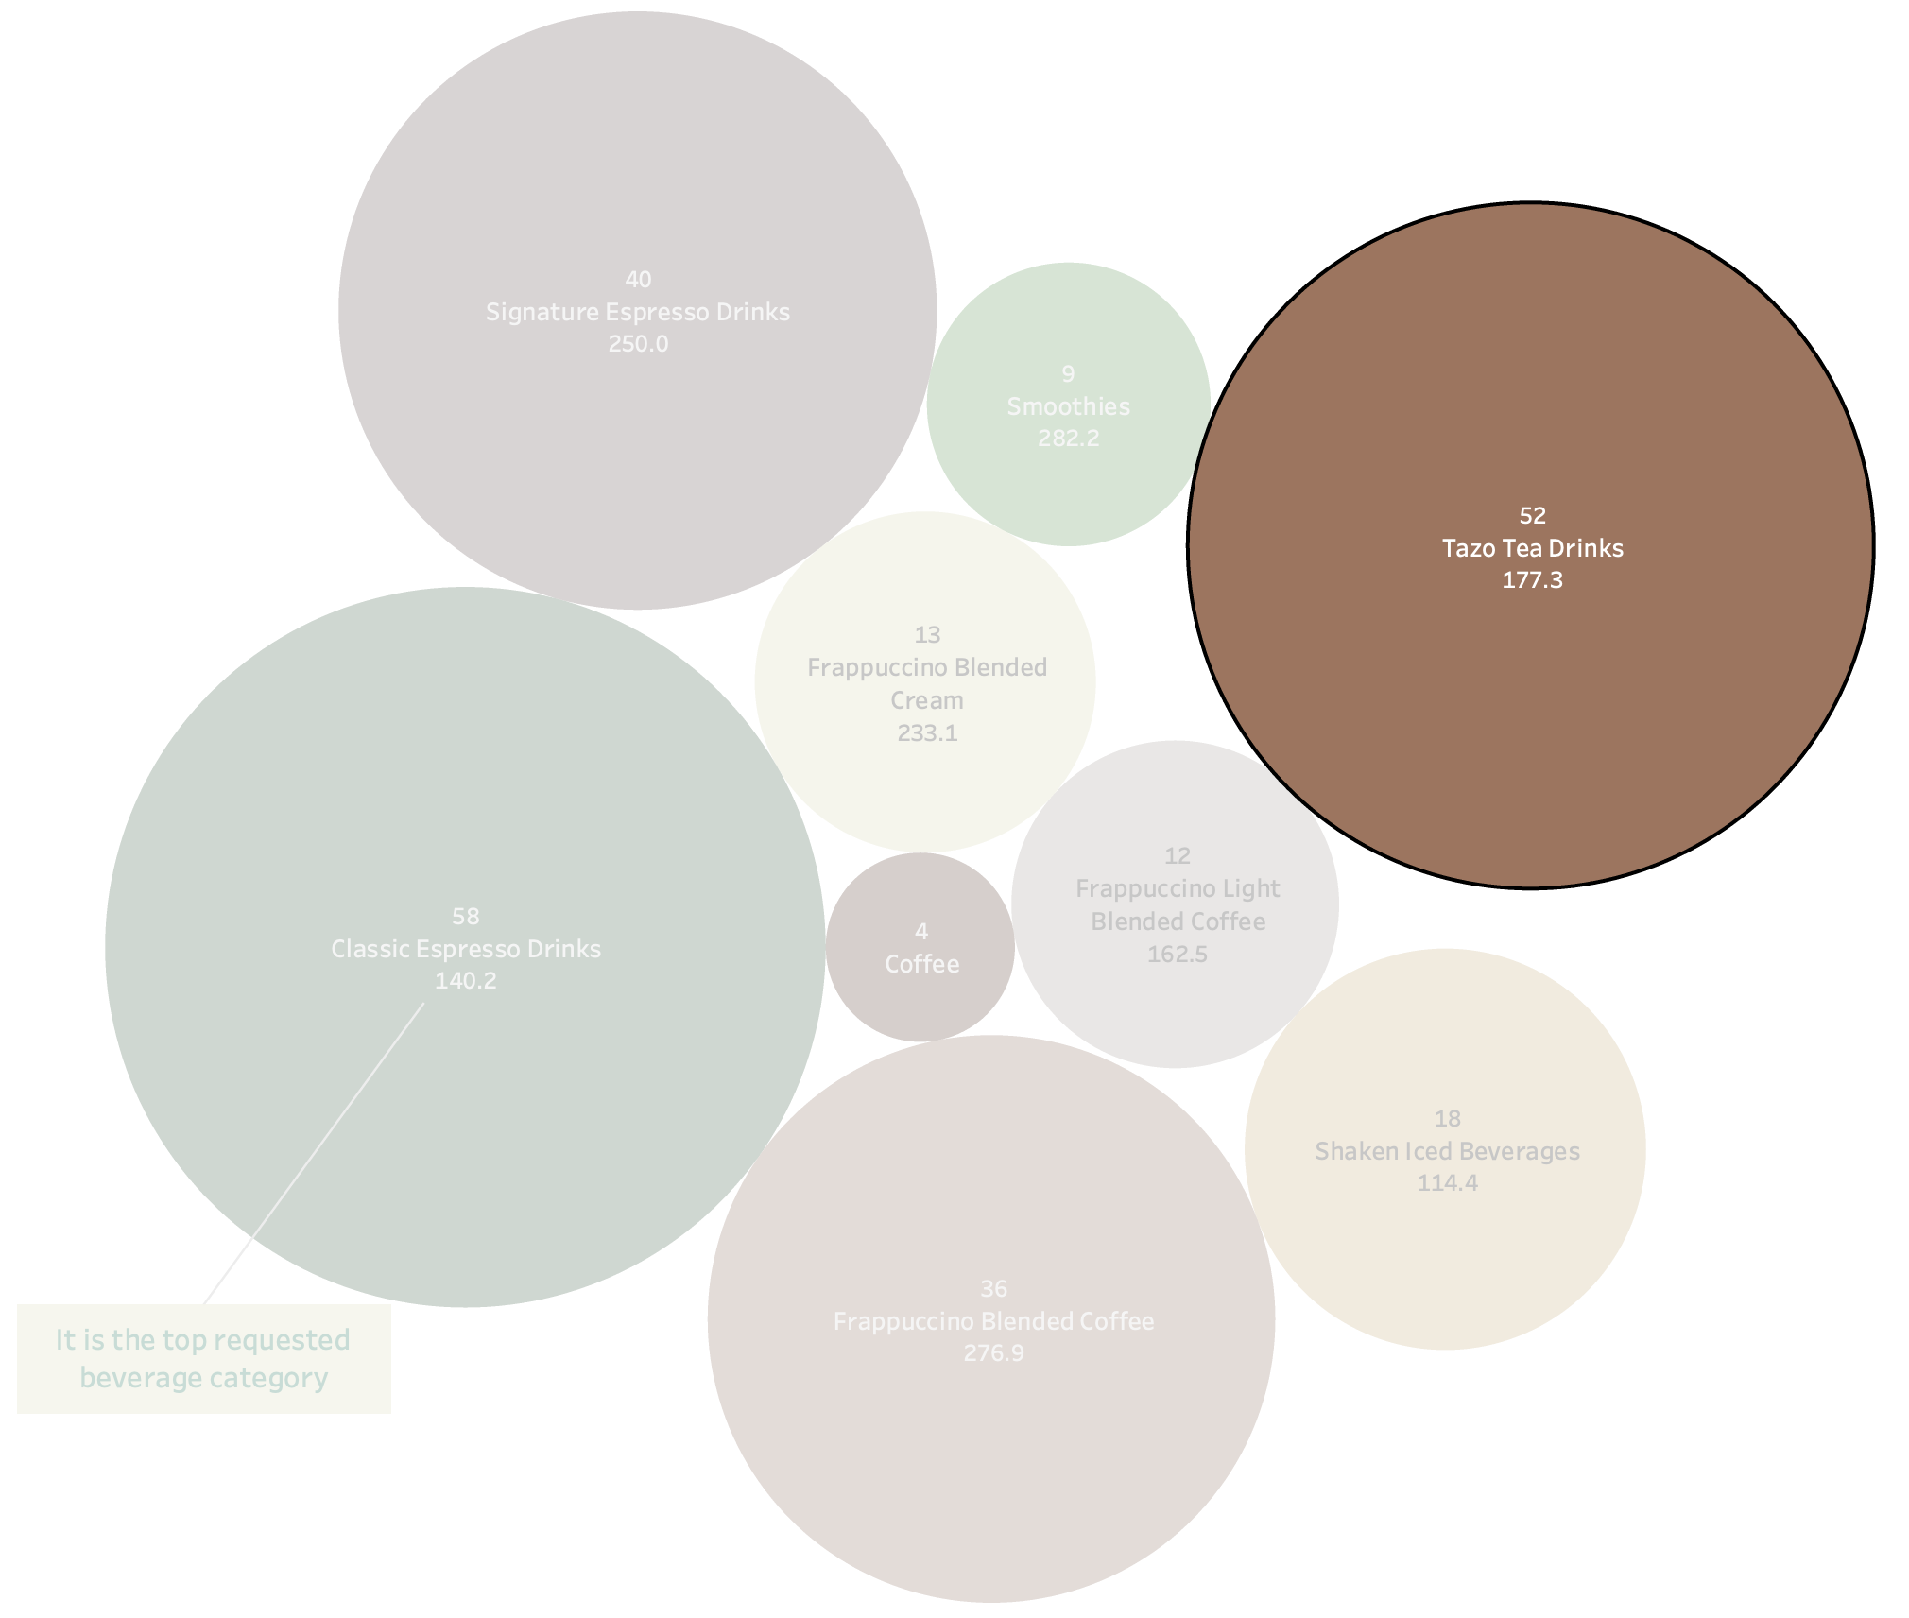

Slide 13
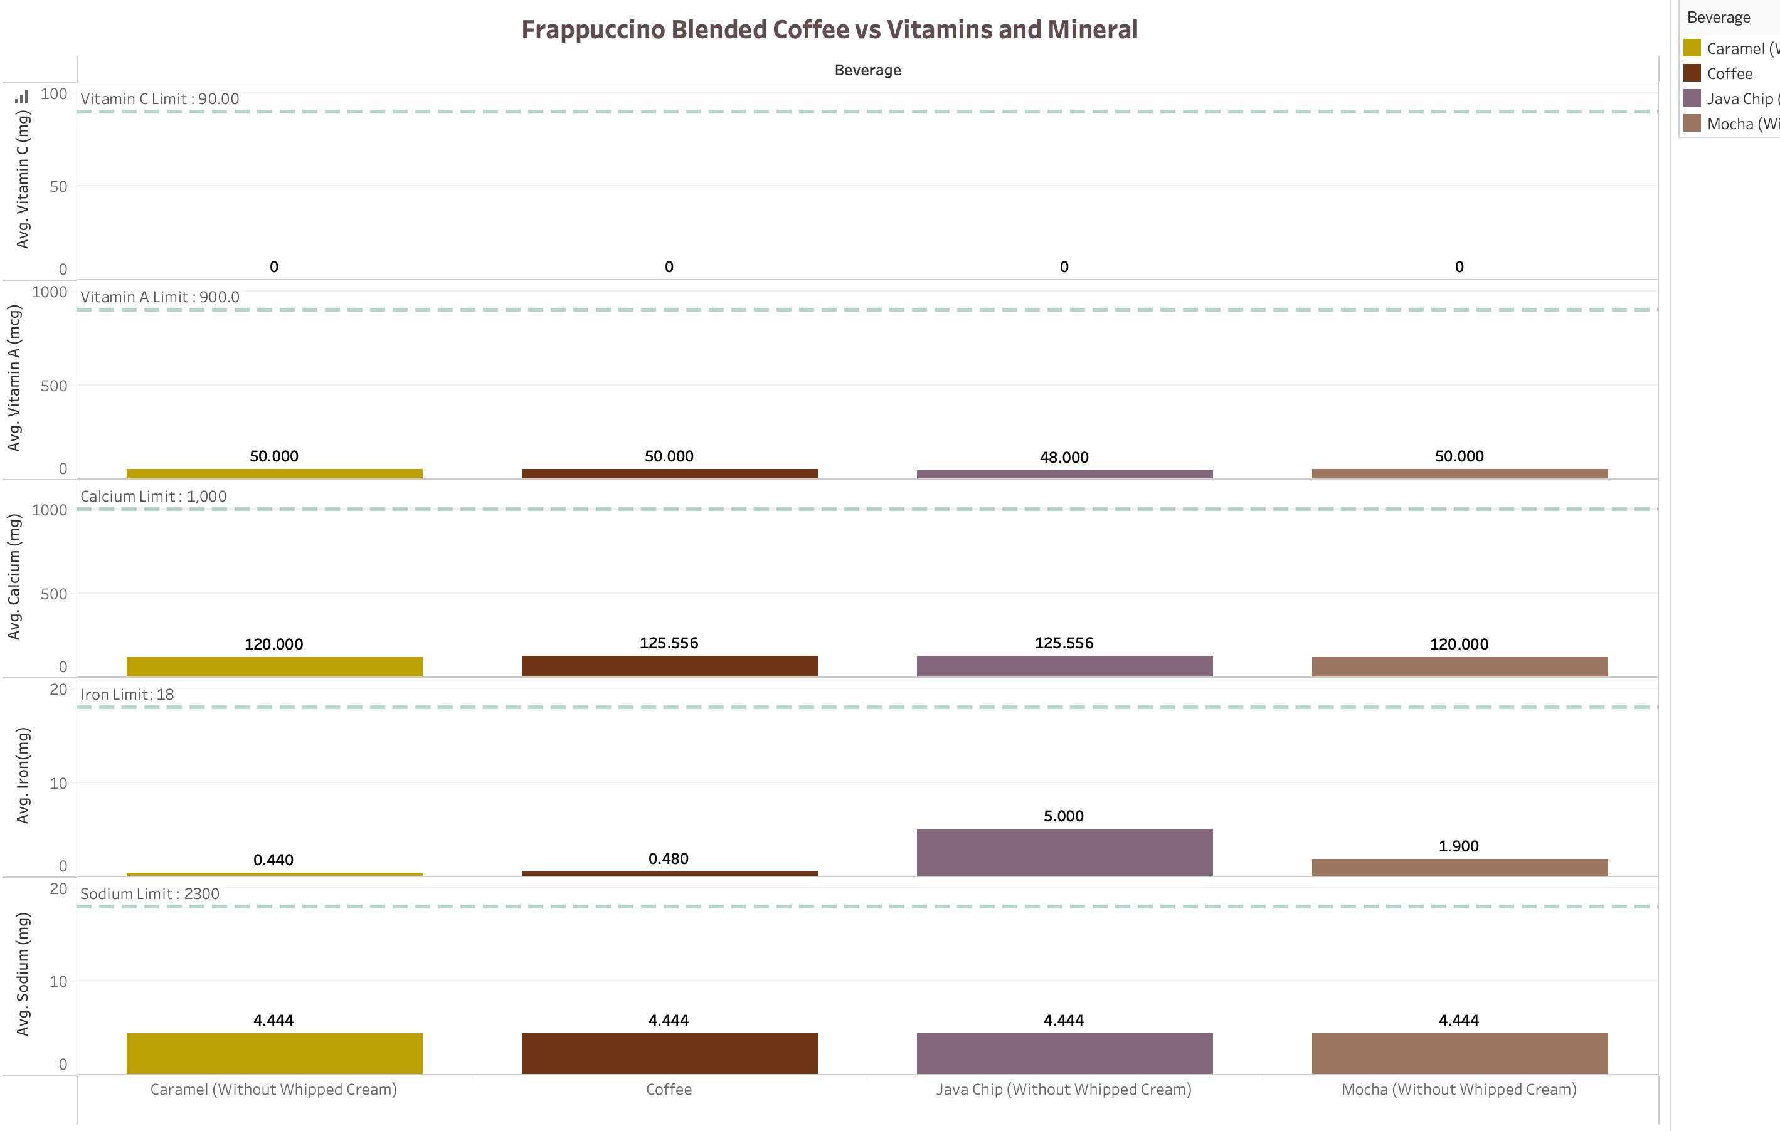
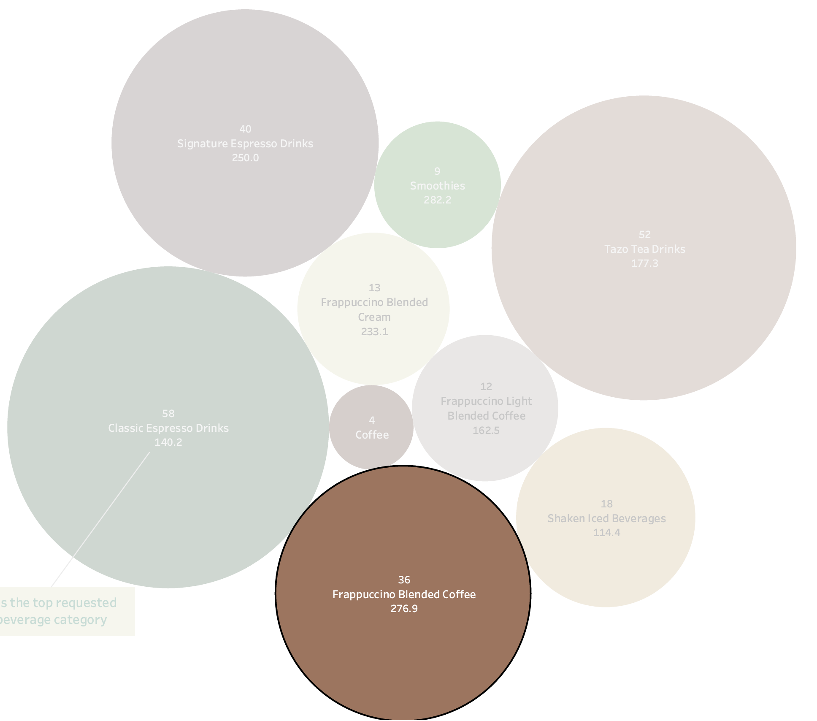

Slide 14
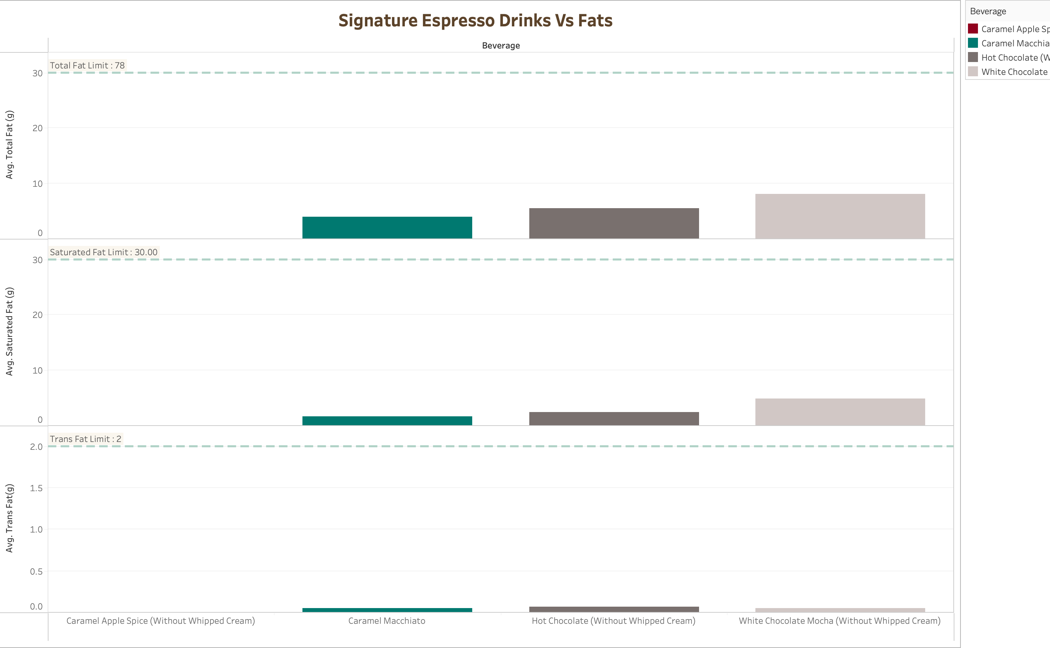
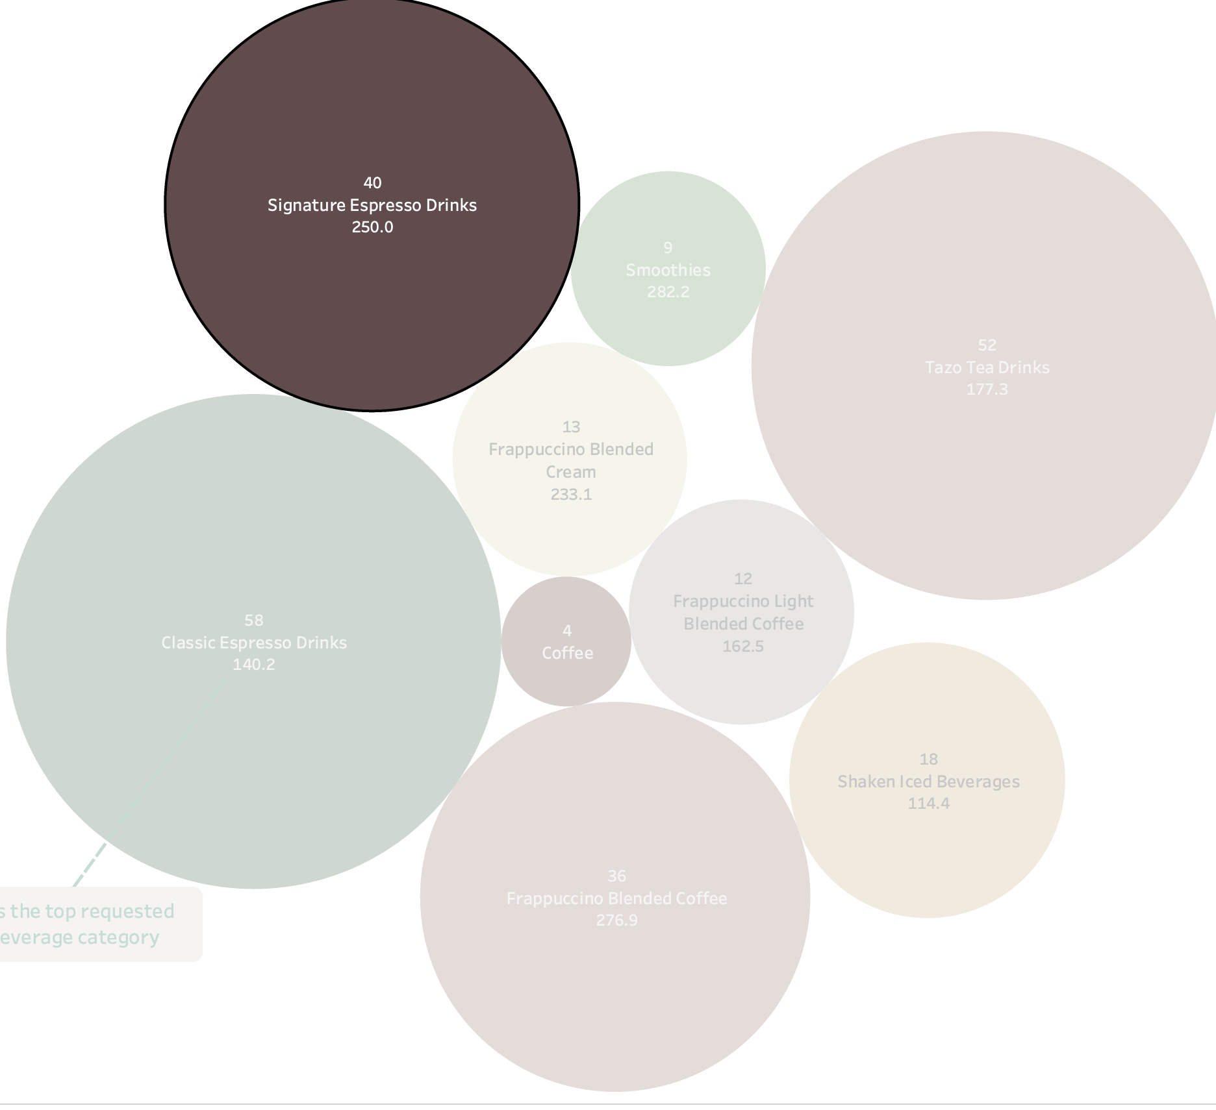

Slide 15
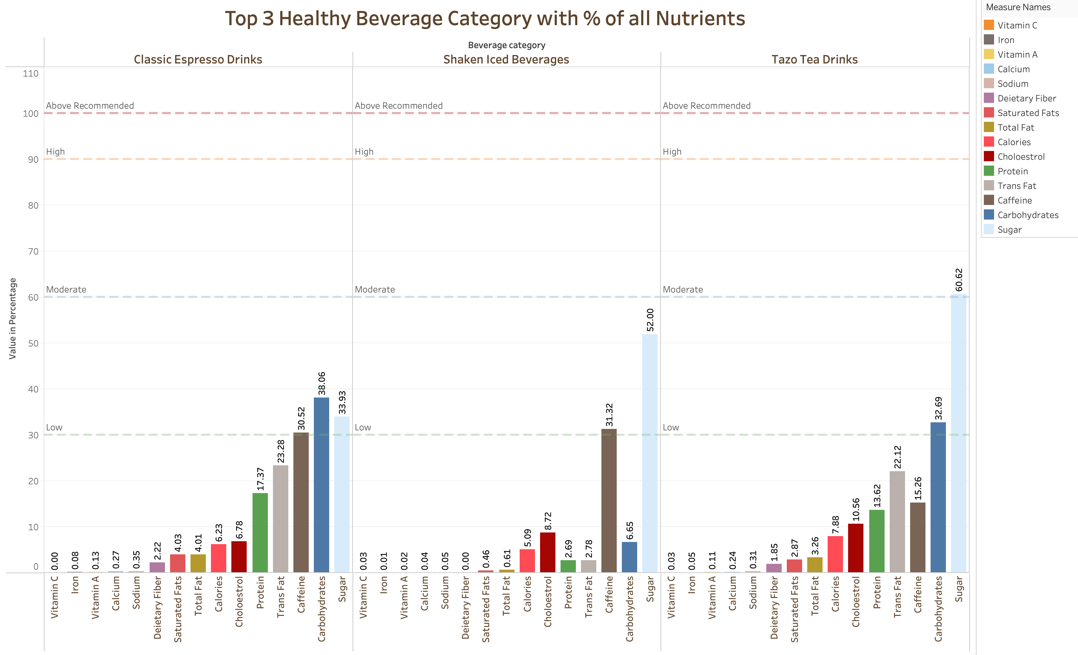

Slide 16
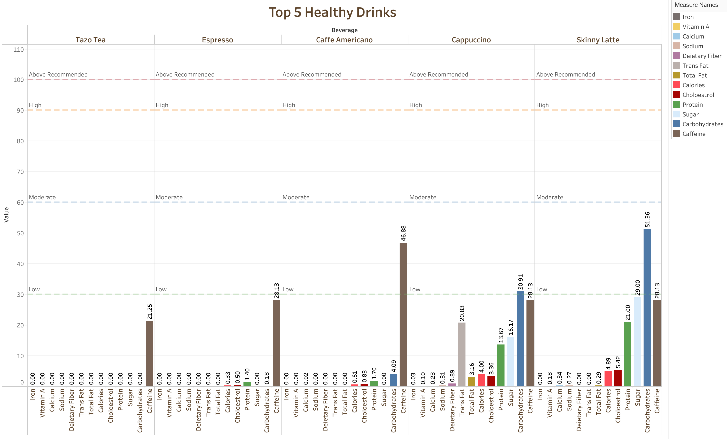

Slide 17
Double Delight
Can you consume a Starbucks drink twice in a day ?

Slide 18
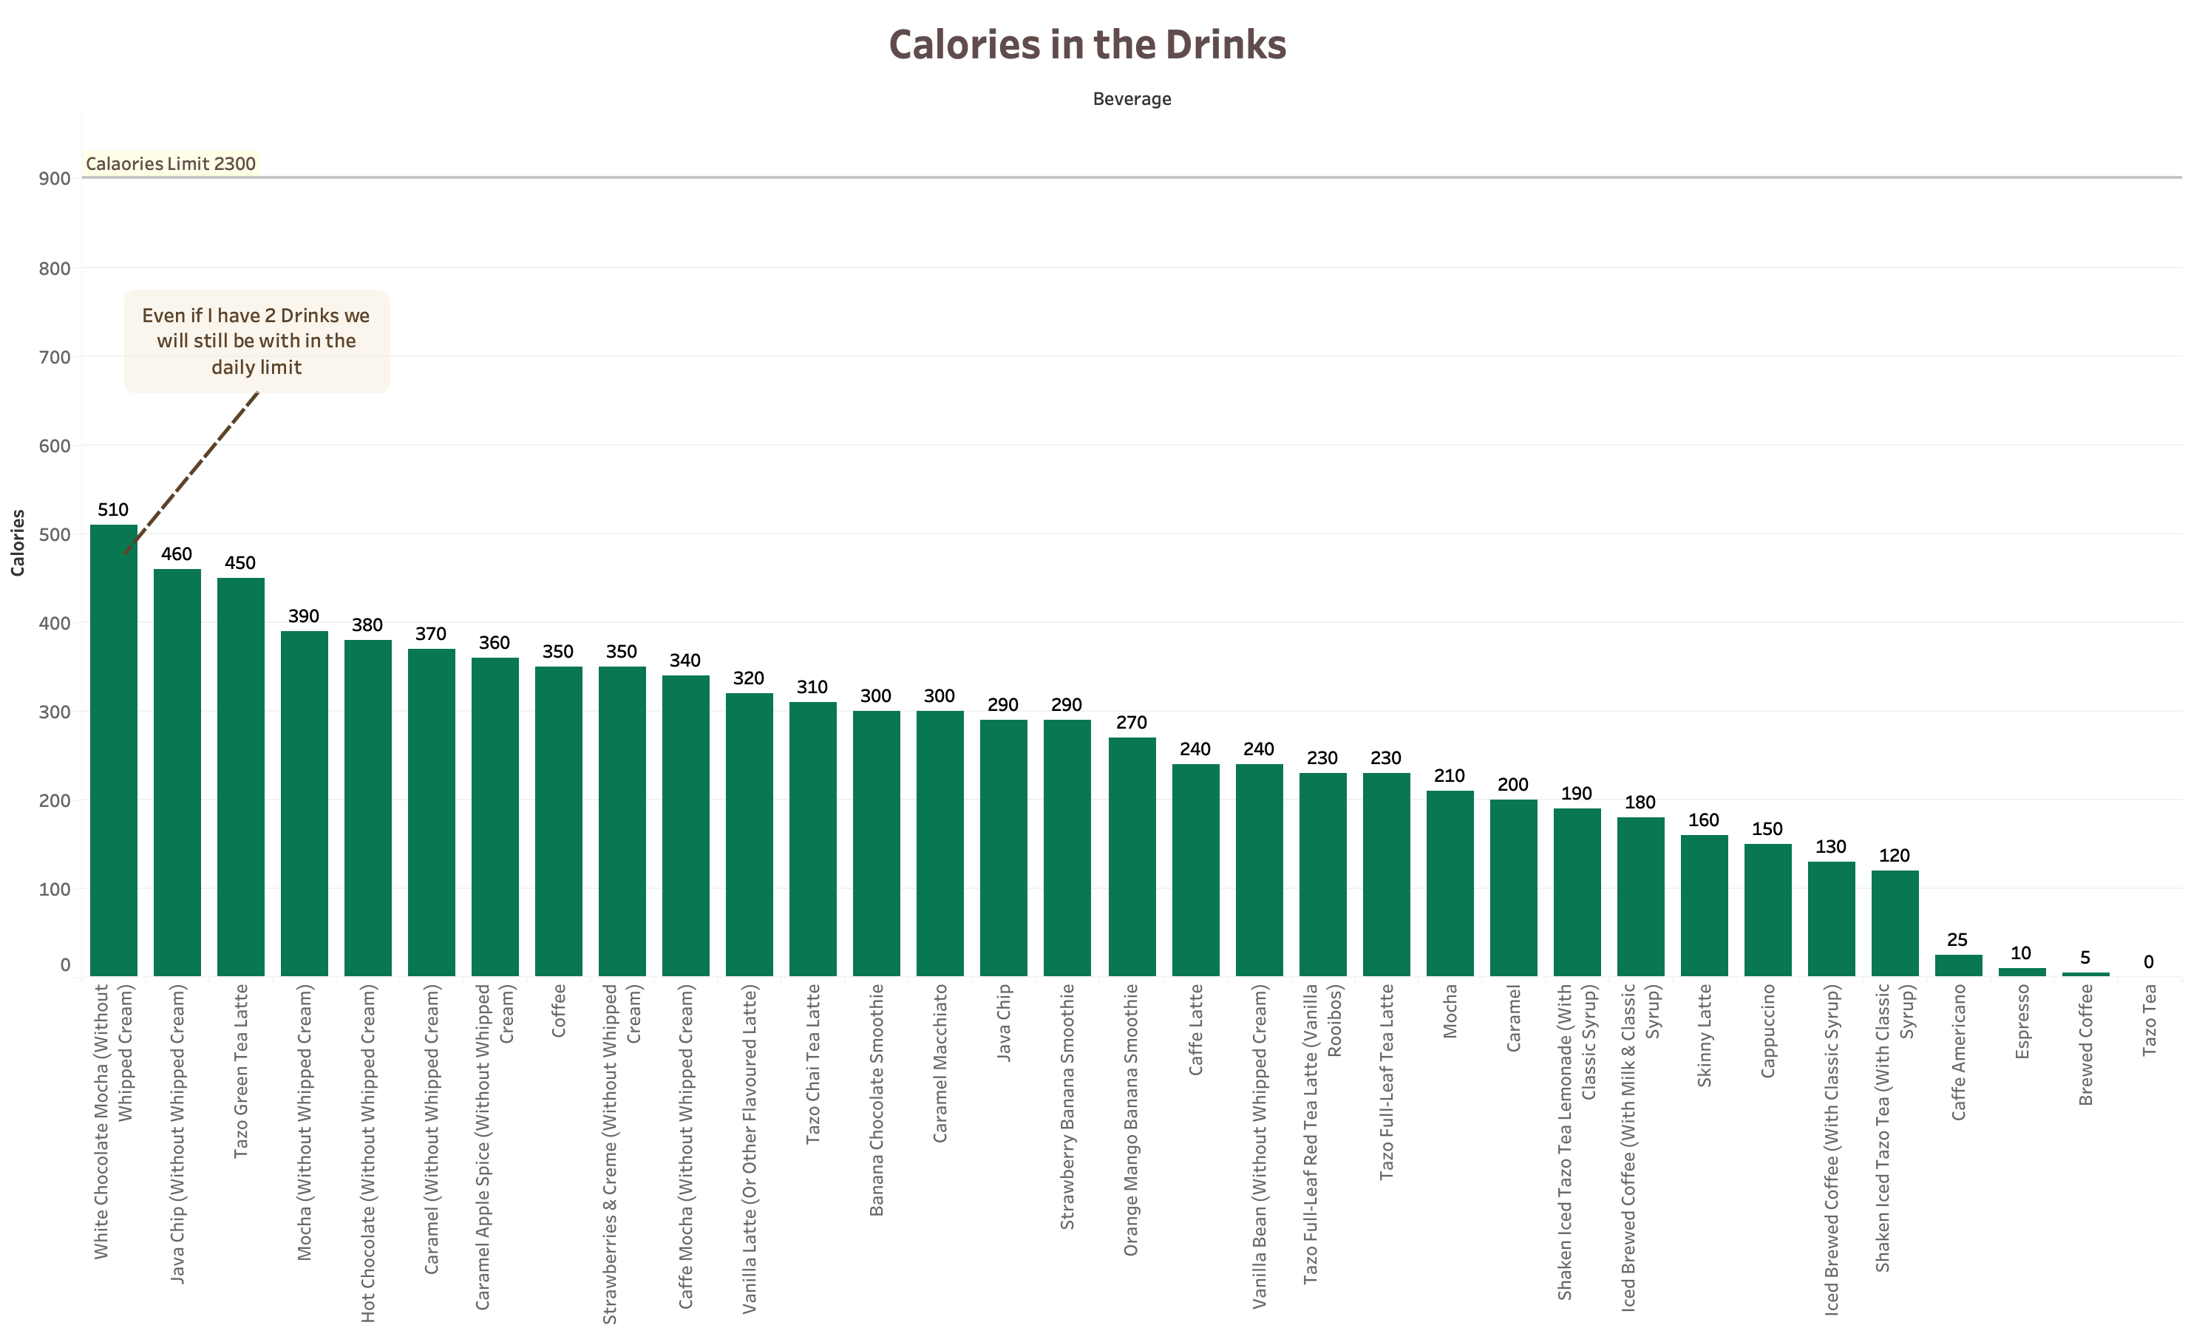

Slide 19
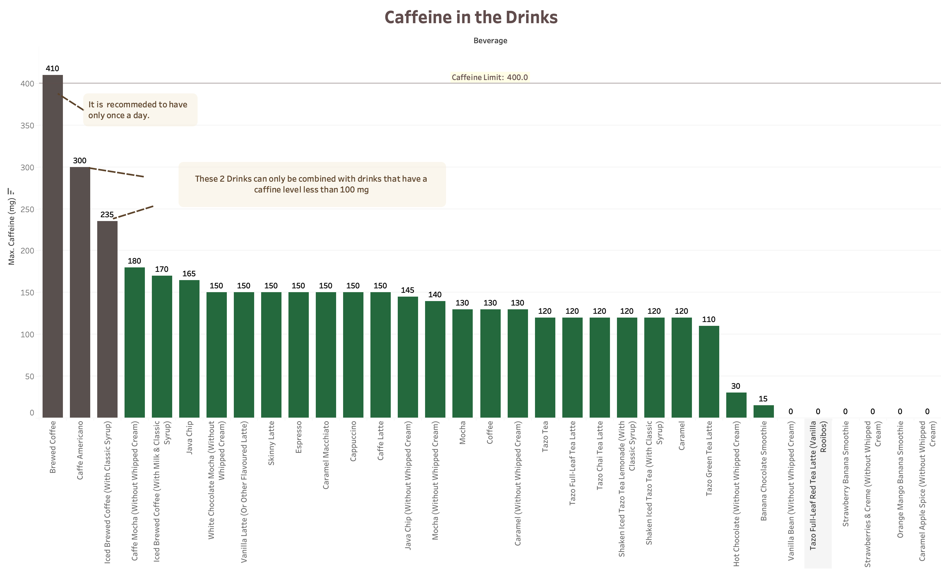

Slide 20
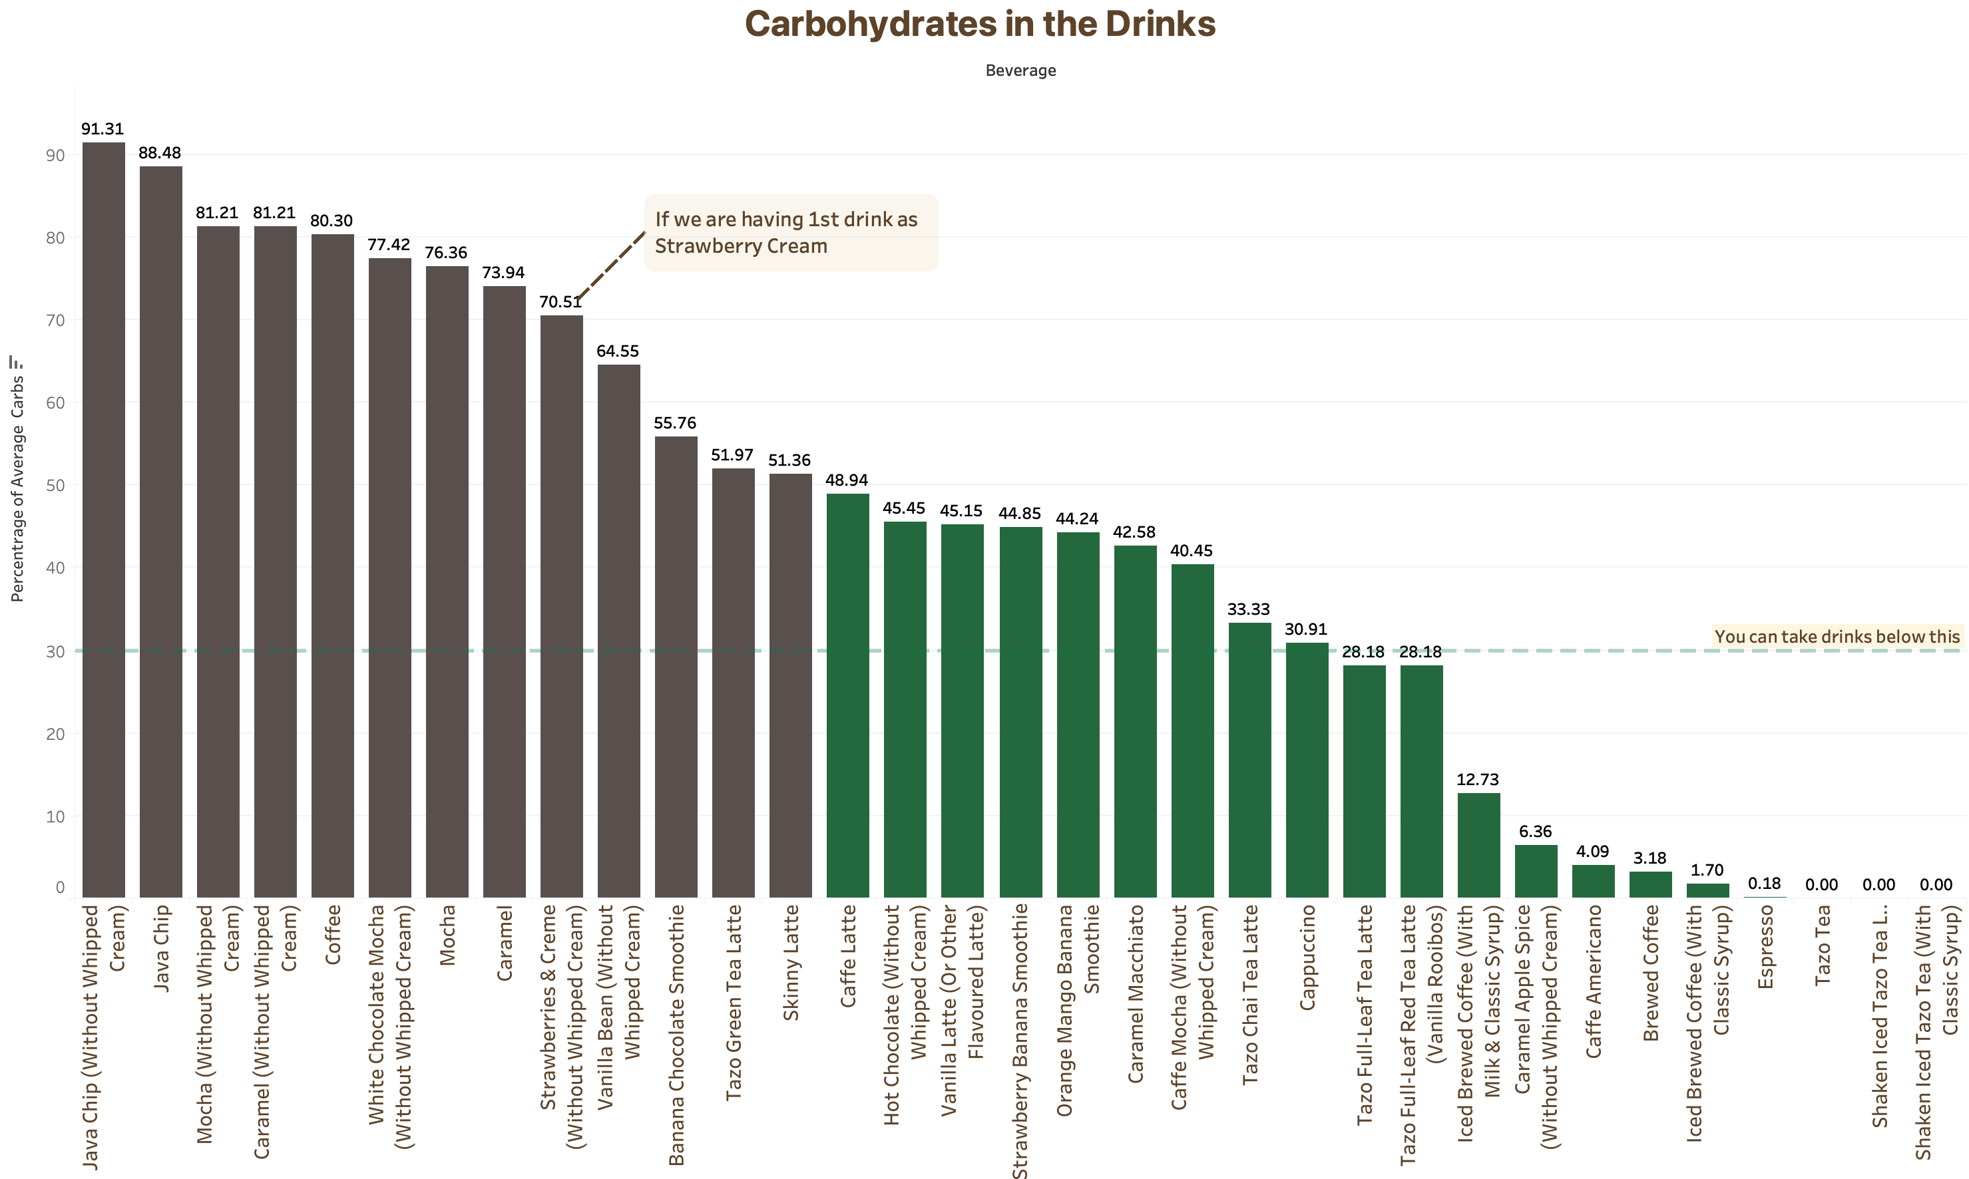

Slide 21
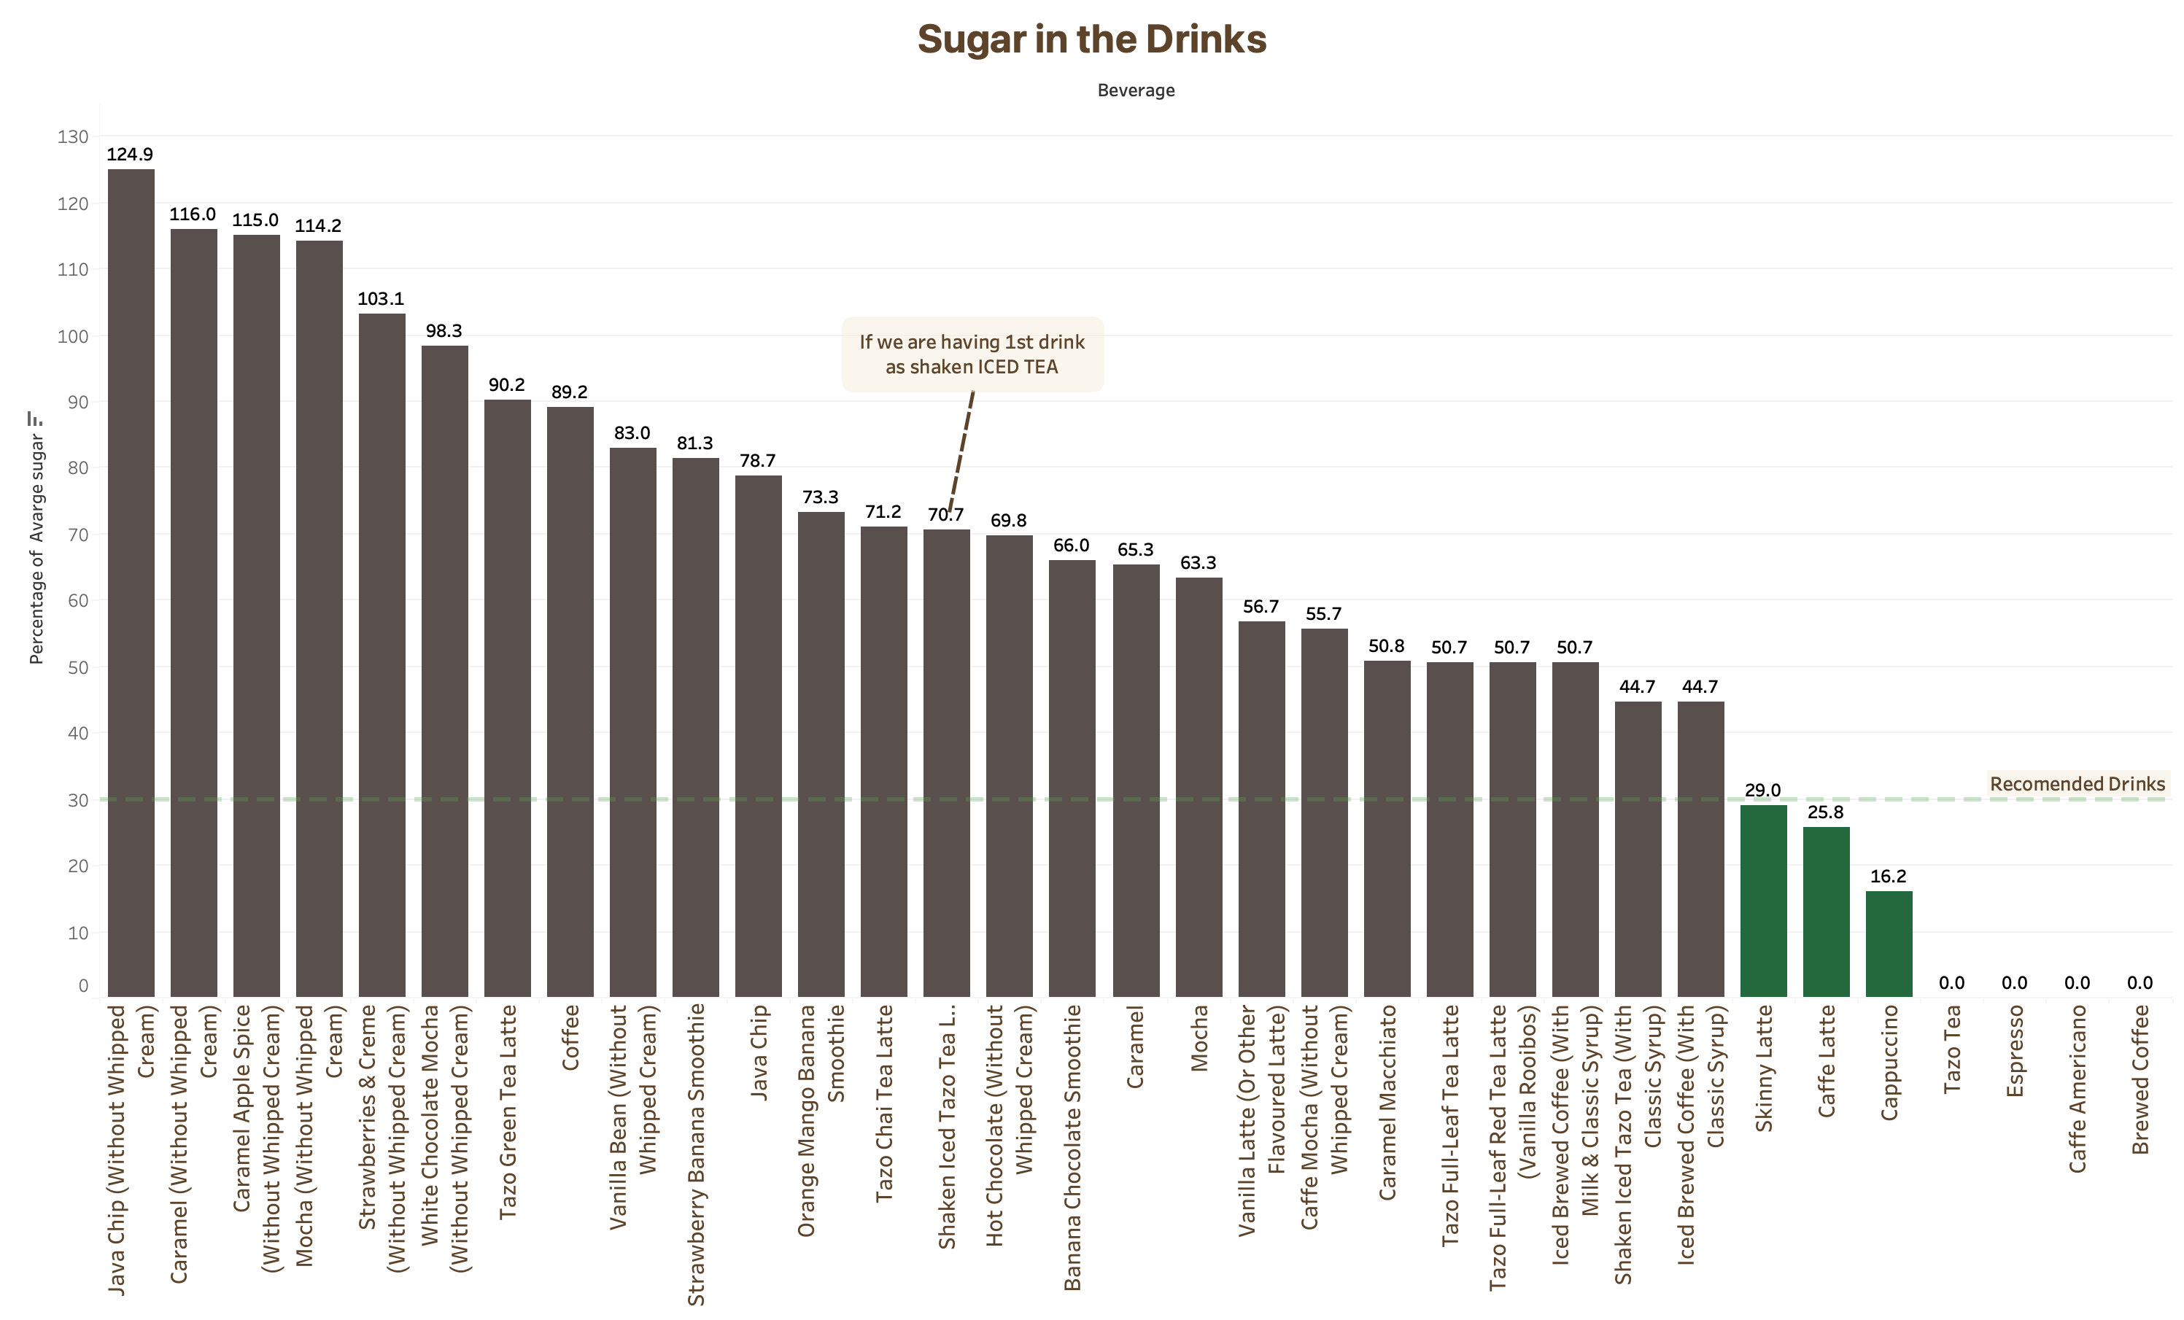

Slide 22
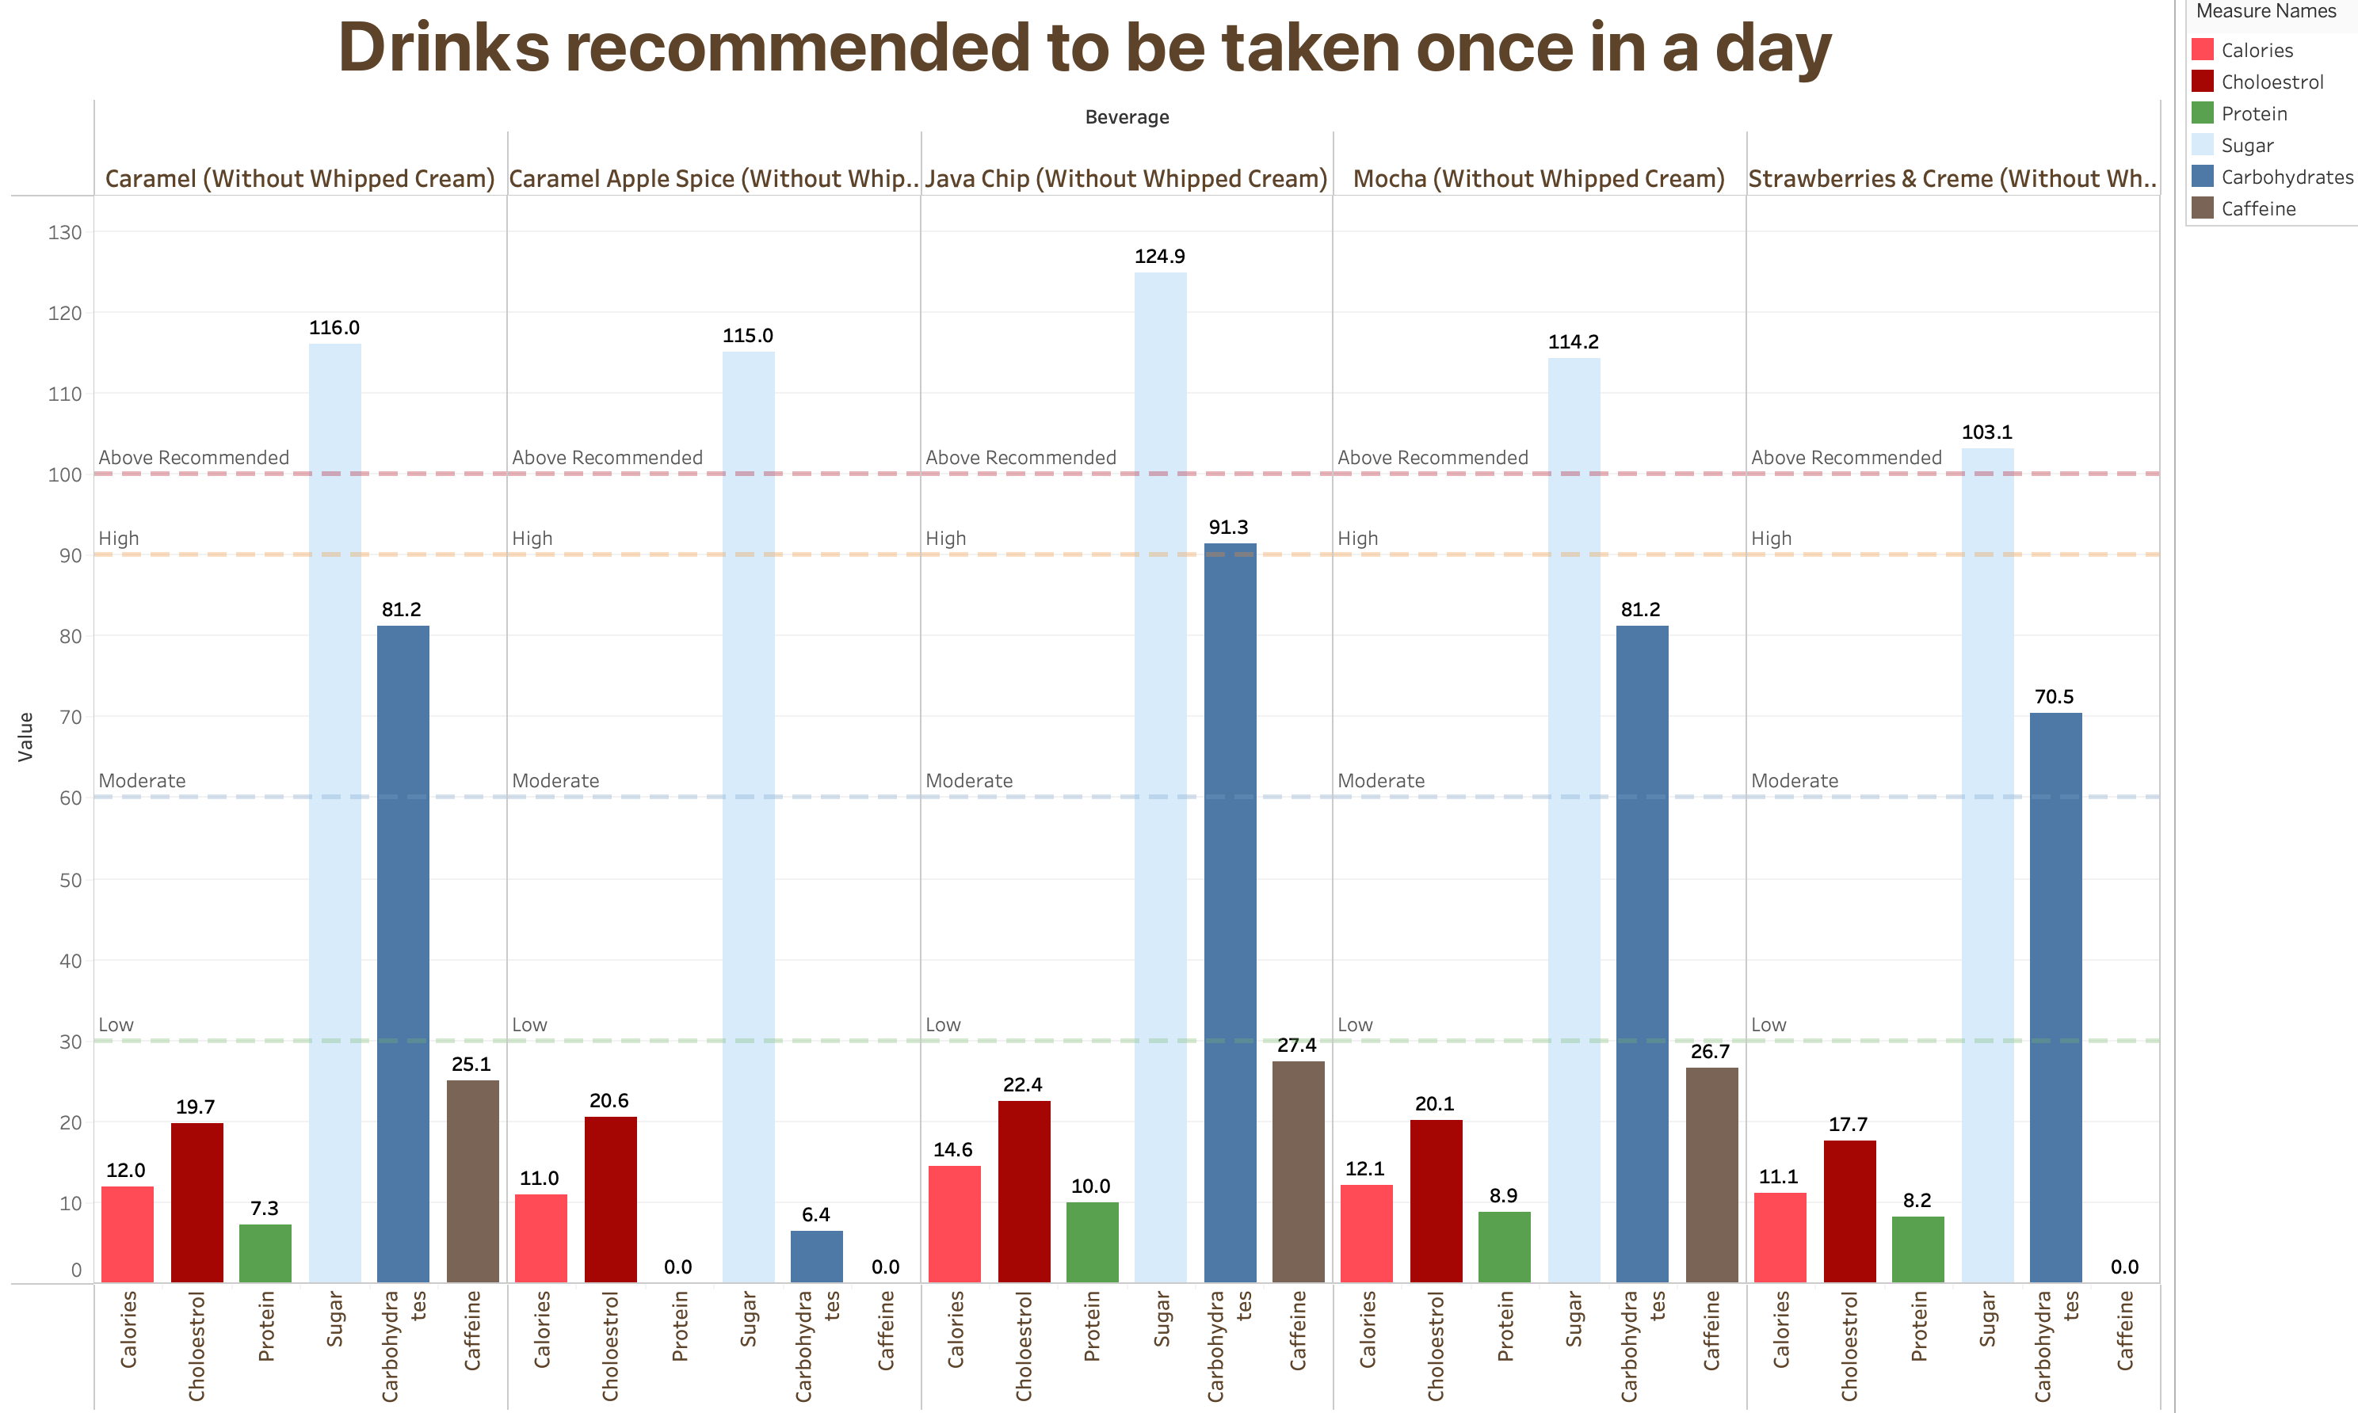

Slide 23
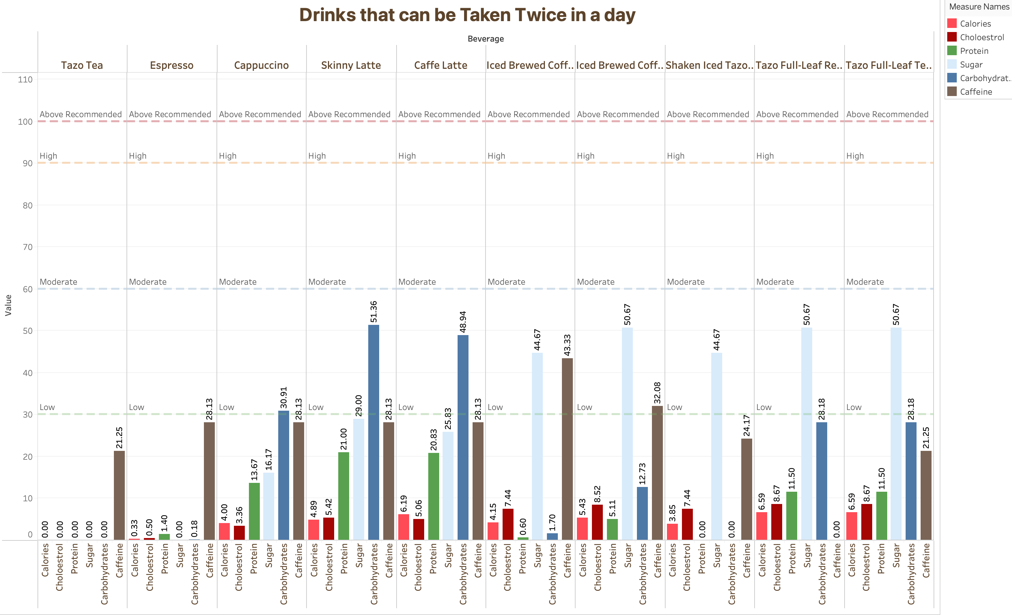

Slide 24

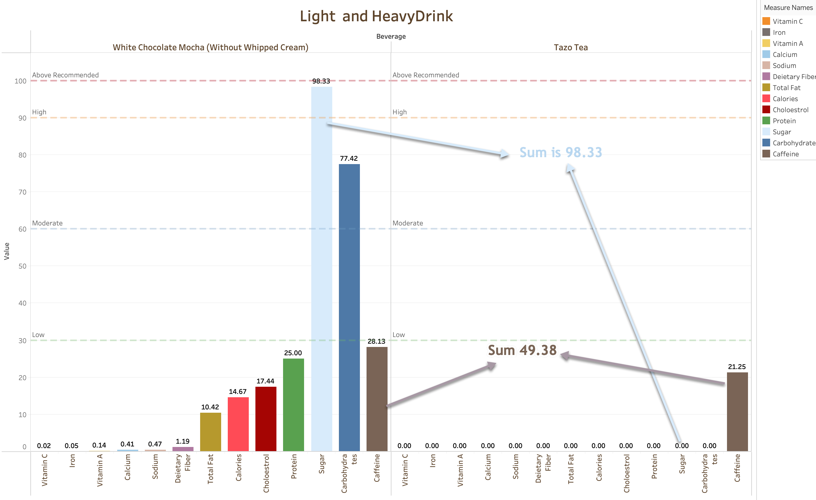
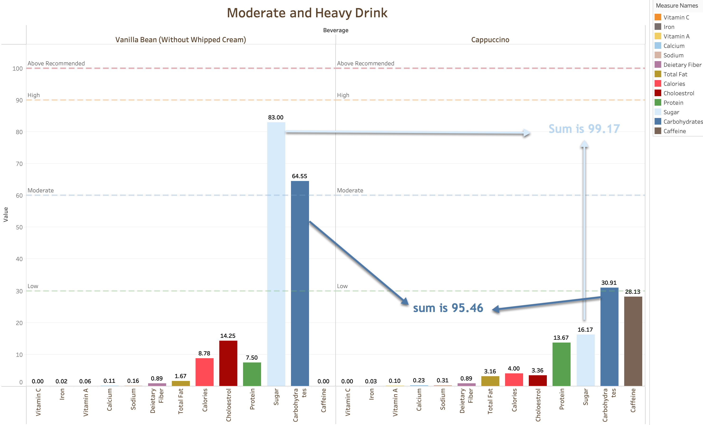
Combination of drinks

Slide 25
Conclusion
As shown the nutrition information of all the beverages in Starbucks.
All the beverages are in compliance with National Health Institutes
Hence, It is safe to conclude that 1-2 cups of Starbucks coffee wouldn’t be bad for health.

Slide 26


